Slide 1
Storytime- Cloud in a jar
Organization:
Date:
Presenters:
Notes:
Italics: what the presenter should say
Bold: what students may respond/say
Regular text: instructions/notes
Hi! My name is __________. In my spare time I do fun science activities with Let’s Talk Science. I study ________ at the University/College of __________. I decided to study ______ because [when I was your age I loved… I think it’s important to …. I’m curious about….]. Once I finish my studies I hope to [career info].
Today we’re going to be talking about energy and the wind! This is an important subject because energy is all around us and it is extremely important to our lives!

Slide 2
Please note your microphones are turned off by default. Nobody can hear you.
Please note your webcams are turned off by default. Nobody can see you.
If you have a question, please put them in the Q&A section!
Notes:
Please note your microphones and webcams are turned off by default.. If you would like to ask a question, you are more than welcome to do so by using the Q&A section! Feel free to to ask questions or share answers throughout the presentation. If students are unaware, let me know where the Q&A section is.
Your last names will be edited so just the initial will be displayed, for privacy reasons.
To let the host know that you are ready to move on to the next step, please use the Raise hand option.
Should you need to leave the webinar earlier, you can do so by clicking the Leave meeting button.

Slide 3
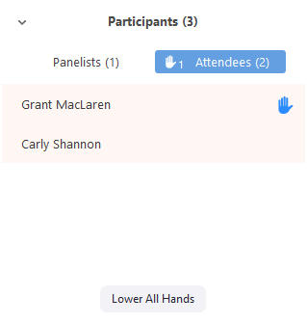
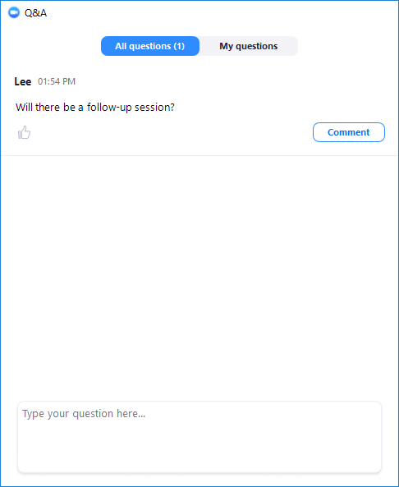
Zoom
Notes:
Please note your microphones and webcams are turned off by default.. If you would like to ask a question, you are more than welcome to do so by using the Q&A section! Feel free to to ask questions or share answers throughout the presentation. If students are unaware, let me know where the Q&A section is.
Your last names will be edited so just the initial will be displayed, for privacy reasons.
To let the host know that you are ready to move on to the next step, please use the Raise hand option.
Should you need to leave the webinar earlier, you can do so by clicking the Leave meeting button.

Slide 4
Indigenous land acknowledgement
Let’s Talk Science acknowledges the diversity of Indigenous Peoples within the land we now call Canada, and values the historical and contemporary contributions of these peoples in each region where we live, work and study. We are committed to working toward meaningful reconciliation and continuing to broaden our understanding in these areas. In particular, we recognize the importance of Indigenous ways of knowing to our understanding of the natural world.
Acknowledging the traditional territory on which we live and work is a small but important step that reminds us to learn more about the Indigenous peoples in these regions, to consider the history and ongoing colonialism on this land and to reflect on how each of us can contribute to reconciliation.

Slide 5
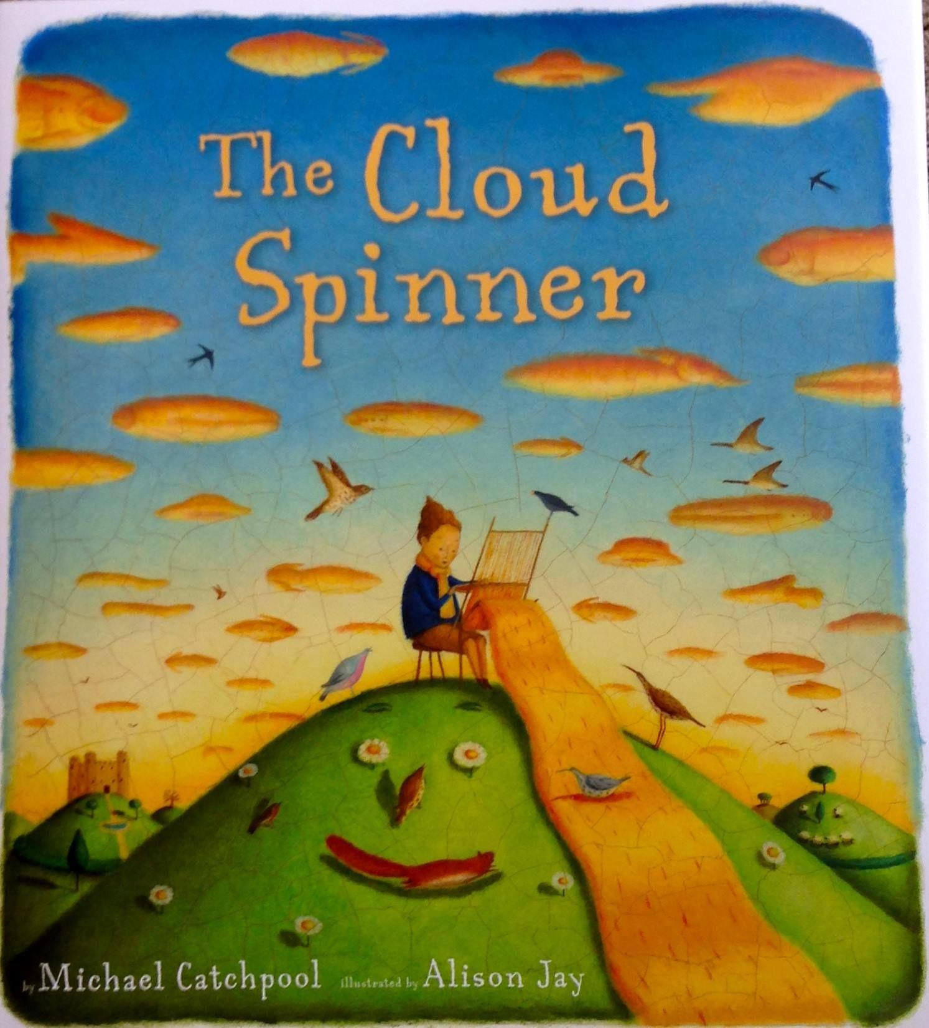
"The Cloud Spinner" by Michael Catchpool
Notes:
Let’s hear a reading of the book "The Cloud Spinner“ by Michael Catchpool

Slide 6
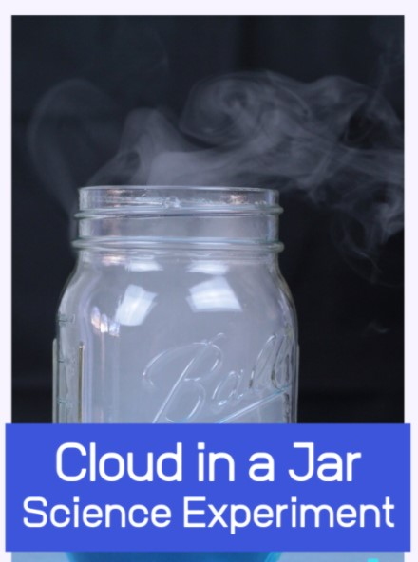
Cloud in a jar
What materials will we need?
Ice cubes
A jar
Hairspray (possible substitute: matches)
Hot water
Optional: food colouring

Slide 7
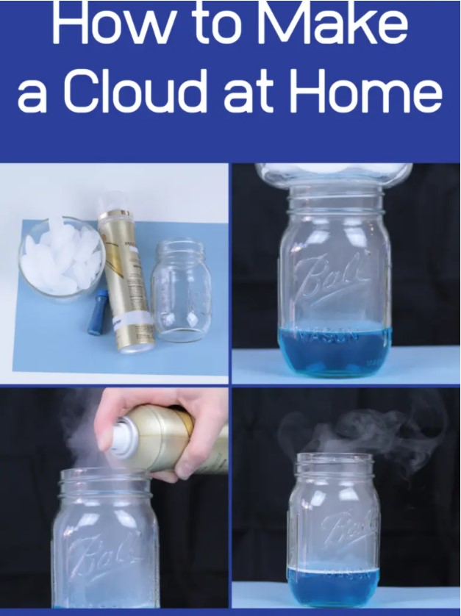
Notes:
1. Pour into the jar approx. 3 cm of steaming water. Cover the jar with plastic wrap. Place ice cubes on top of plastic wrap.
2. Students observe and record their observations for several minutes and put up their results in the Q&A section:
What happened after the ice was put on top of the jar? Where did the water come from? Discuss the way clouds are formed.
3. Summarize by having students connect what happened in the jar and the water cycle.
Modification: Make a jar with wrap on it and ice on the wrap but without water. Water from the air condenses – where did the water come from? Have students guess. Answer: water from inside the jar (air in the jar has some water) condensed on the plastic wrap.
Discuss what was learned today and review the water cycle and key words: evaporation, condensation, expansion, contraction, solid, liquid, gas.

Slide 8
Thank you for joining us!
We hope you had fun!
Follow us on Twitter/Facebook @LetsTalkScience or visit our website
If your caregivers are okay with it, take a picture of your experiment and tweet it @LetsTalkScience with #STEMathome
Notes:
Thank you so much for having us today, we hope you had fun and learned something new. Feel free to take pictures of your experiment and tweet it @LetsTalkScience with #STEMathome. You will actually receive a document after this session with a link to our website, twitter, as well as an extra activity.

