Slide 1
Bees

Slide 2
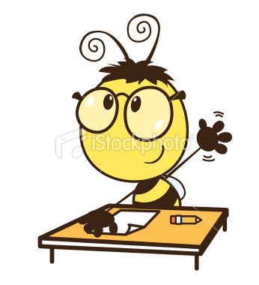
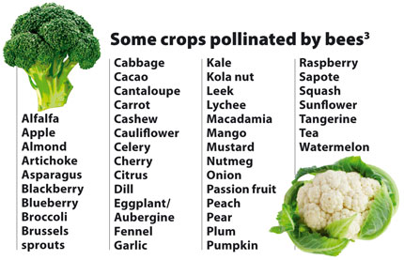
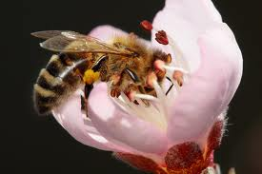
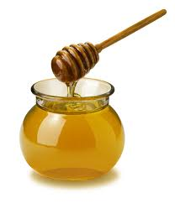
I love bees
Notes:
Why do you love bees?
Why do you not love bees? (explain that bees don’t sting unless provoked. Many people think they’ve been stung by a bee but they have been stung by a wasp instead)
I love bees because… they pollinate our food (about 1/3 of our food crops world wide are pollinated by bees); they are so smart, they are cute and fuzzy!
Some are also endangered of going extinct (Gypsy cuckoo bee and Rusty Patch Bumblebee in Ontario for example). Threats to bees include pesticides, loss of their habitat due to humans building houses or malls, etc. and agriculture for crops, climate change and diseases.

Slide 3
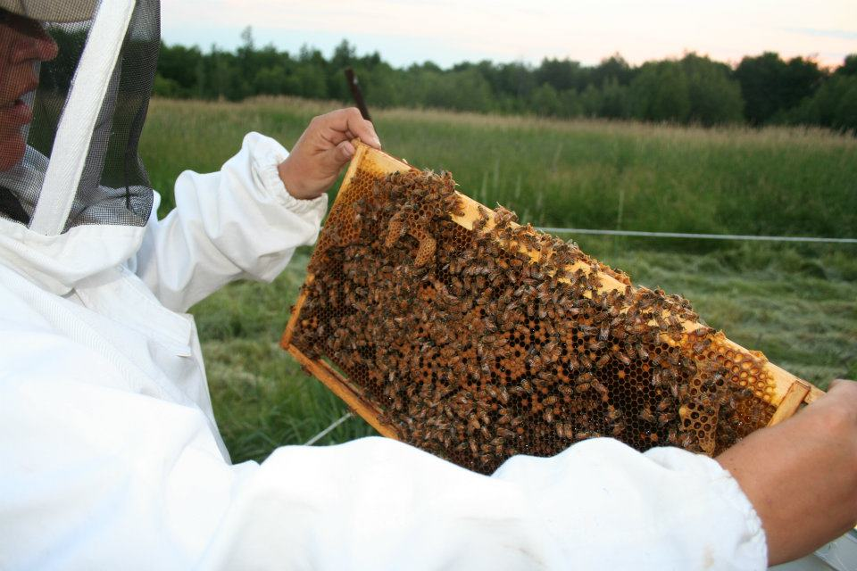
Notes:
This is what a beehive looks like when someone raises bees. This is Isabel and she and her husband Ray raise bees.
Beekeeping means taking care of bees: giving them a home, medication when they need it, food when there isn’t food around, and water in exchange – the bees give me honey.
If they aren’t happy with their accommodations, they will leave! So I have to take good care of them.
Varroa are a parasitic mite that like bees, so Isabel might give her bees a special medication to help prevent these mites. Pass around the photos of the bee with a red spot near its head.

Slide 4
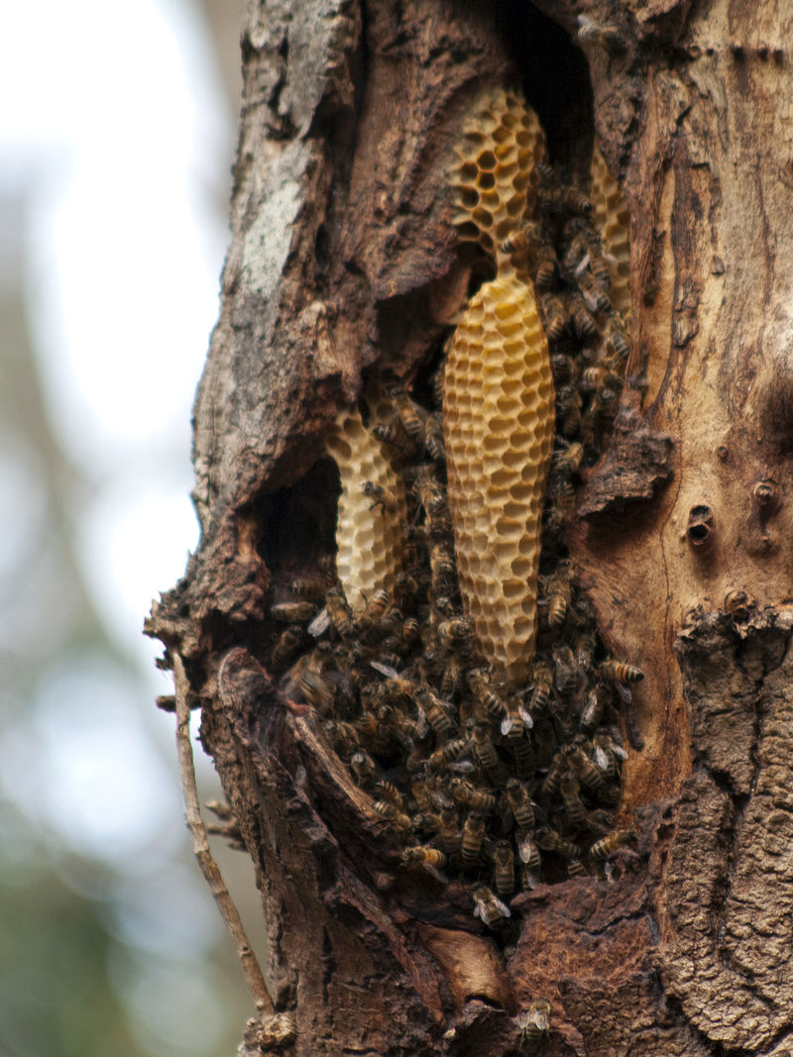
A bee’s life
By Bilby - Own work, CC BY 3.0, https://commons.wikimedia.org/w/index.php?curid=11444778
Notes:
Has anyone ever seen a beehive in nature? Here’s what it might look like. Honey bees don’t hibernate. They huddle together to keep warm in winter.

Slide 5
A bee’s life
1
6
2
4
3
5
Notes:
Let’s see if we can figure out the life cycle of a bee.
Give the students a few minutes to see if they can decide the order of the bee life cycle. They can write down the numbers associated with each photo in the order they think they go.

Slide 6
A bee’s life
Notes:
Answer key for bee development cycle

Slide 7
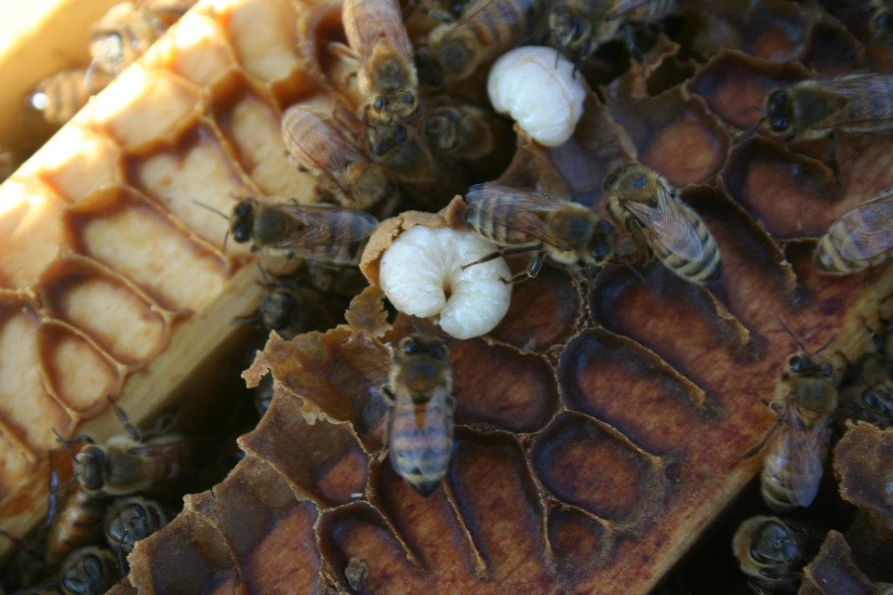
A bee’s life
Notes:
These are larva (white). The bees feed their larva royal jelly. Royal jelly is a special food that is nutrition for the larva and is secreted from glands in nurse bees.

Slide 8
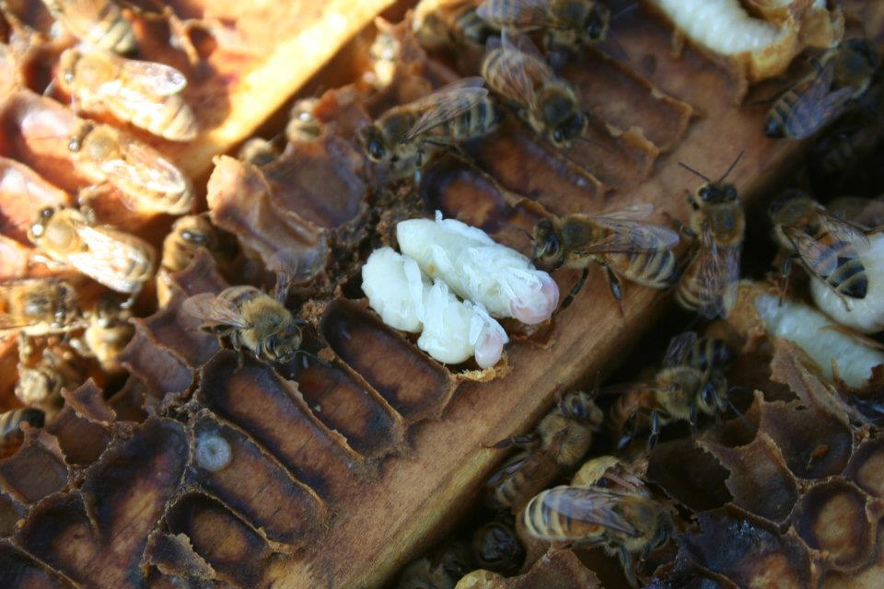
A bee’s life
Notes:
The larva get sealed inside a honeycomb by a wax cap, and transform into pupae.

Slide 9
A bee’s life
Notes:
Can you see the bee being born? (Coming out of cell, upper right)
Before we move on to a few more cool things about bees, let’s see if we can make a bee.
What type of animal is a bee? [insect] What do all insects have [3 body parts, 2 antennae, 6 legs].
Hand out 3 foam balls, 2 toothpicks, 6 longer pipe cleaners and 2 small pipe cleaner pieces for antennae.
Show students how to put the balls together with the toothpicks.
Before you put the legs on, what are the names of the body parts? [head, thorax, abdomen]. Which body part do the legs go on? [thorax]. Go ahead and add legs and antennae.
Now what other features do bees have that not all insects have? [wings, stinger, and a special mouth part called a proboscis].
Hand out 2 long pipe cleaners per student (or have them come and get them from a central pile), 2 more short pipe cleaners (stinger and proboscis).
The proboscis is a mouth part that rolls up when the bee isn’t using it but stretches out to allow the bee to get deep into the pistil on the flower where the nectar is.
Lastly hand out two eyes to each student as they are adding the things above.
Now you have a bee. ☺ Let’s take a look at a few more things about bees.

Slide 10
Notes:
Once bees are born, they have a lot of jobs! A worker bee’s life is about 6 weeks long and there are about 20,000 to 80,000 in a hive (their habitat).
Worker bees are females. Male bees are born called drones and their main job is to mate with the queen.
Day 1-2: hive clean up duty
Day 3-11: nurse bee, their glands produce royal jelly to feed larvae
Day 12-34 worker bee: their glands produce wax to build the honeycomb
Day 22-42: forager bee, goes to get pollen and nectar
Some bees have roles like moving around nectar, fanning the nectar to make it into honey, being a soldier (guarding the hive)
Will show you some pictures from last summer of these activities

Slide 11
Making honey
Notes:
In the process of gathering nectar, the bees pick up pollen and transfer it from 1 flower to another. They use their proboscis to gather the nectar.
Nectar is a sugar called sucrose and enzymes turn this sucrose into glucose and fructose. We have an enzyme in our mouth in our saliva (salivary amylase) that helps to break down sugars like fructose and glucose). The fanning that some of the bees do, helps to remove extra water from the sugar and protects it from germs/microbes.

Slide 12
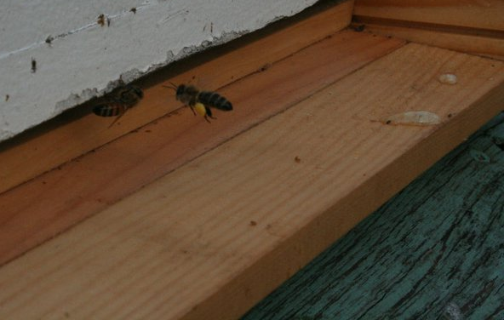
Making honey
Notes:
bringing back nectar and pollen

Slide 13
Making honey
Notes:
Storing pollen (colored cells) and nectar (shiny wet cells)

Slide 14
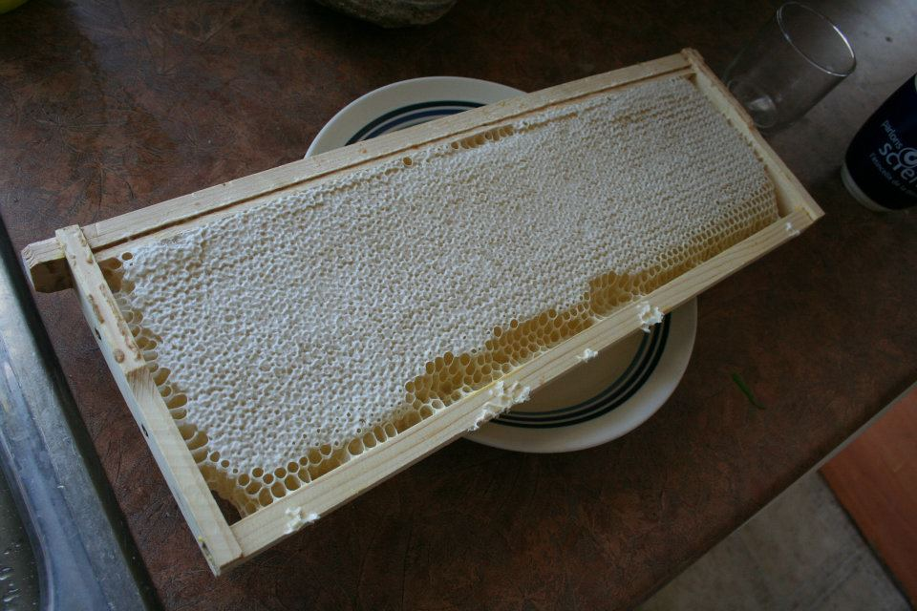
Making honey
Notes:
This is what the inside of Isabel and Ray’s beehive looks like when it is filled with honey.

Slide 15
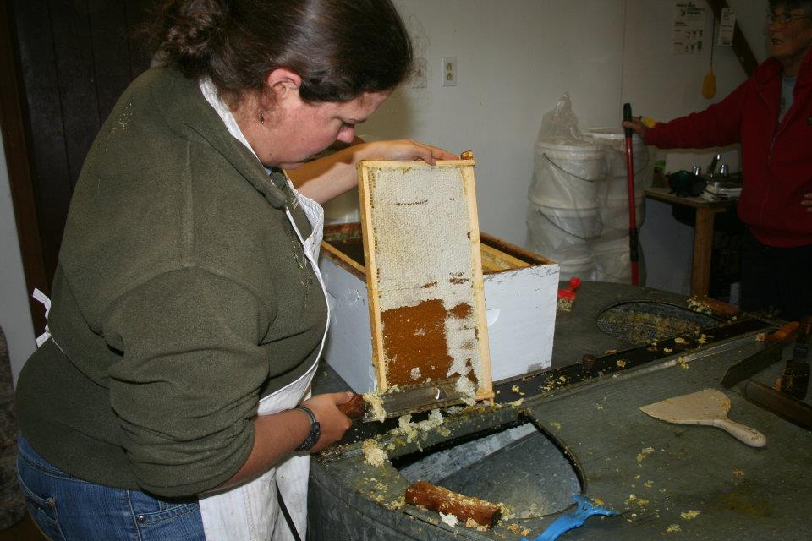
Making honey
Notes:
Isabel scraping off the wax caps to drain out the honey.
Let’s see if we eat like a bee and use a proboscis (party blower) and a flower to try to collect nectar.
Do the activity

Slide 16
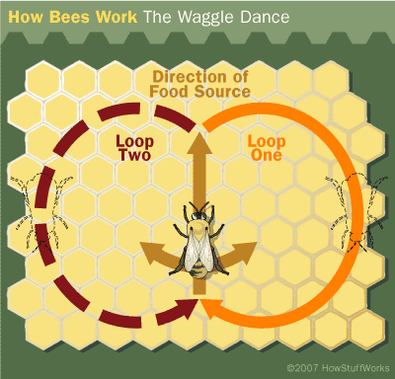
How bees communicate
Notes:
Bees communicate using what we humans call the waggle dance. We’ll watch it on this video.
https://www.youtube.com/watch?v=-7ijI-g4jHg [to watch a bee do the dance]
Wrap up: Without bees we wouldn’t have many foods we eat. Pesticides we use in agriculture, sometimes on our lawns, and other areas, are threatening the bees survival. There are many groups working to ensure we save the bees. One way we can do that is to plant flowers that bees love, use less or none of the pesticides that kill bees, and just be aware of the importance of bees can help people want to take care that they don’t kill them.

